Slide 1
App in a Day Microsoft Power Platform
Power Apps
Power Automate
Microsoft Dataverse
13 April 2023

Slide 2

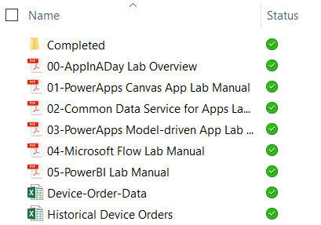
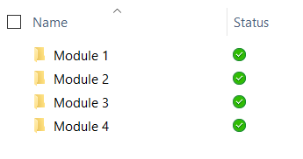
Lab content
Package: https://bit.ly/41u0JfW
Unzip the package on your local machine
Follow instructions: “01 - Create A Machine Ordering Power Apps Canvas App”
Lab docs:
Contains 4 modules with a lab doc for each:
01 - Create a machine ordering Power Apps canvas app
02 - Create a Dataverse table for the machine ordering app
03 - Create a model-driven Power Apps app for machine ordering
04 - Integrate a Power Apps app with Power Automate
Completed modules:

Slide 3
Lab overview
Canvas App
Dataverse
Model-driven
App
Power Automate
Notes:
This slide is intended to set the stage for all of the lab content and morphs into the following slide in show mode
The first lab is centered around Accessing & Preparing the data
Then we’ll cover Data modeling and explortation
After lunch, we’ll look at the different ways we can visualize the data using PowerBI on different platforms
Lastly, in labs 4 and 5 we’ll review publishing, accessing, and building & sharing dashboards

Slide 4
Hands-on-lab 1
Module 1: Power Apps Canvas App

Slide 5
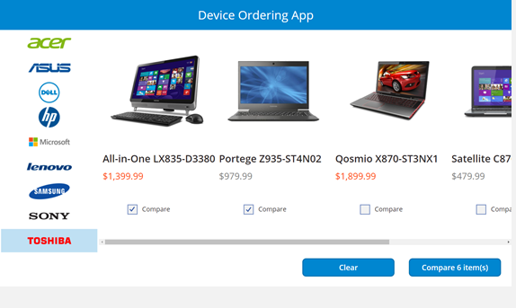
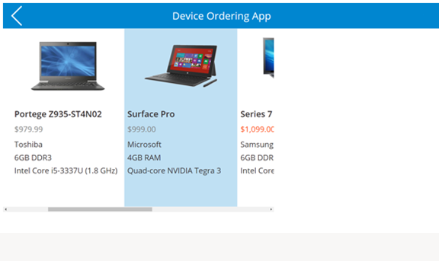
Module 1:Learning objectives
Canvas App
Dataverse
Model- driven
App
Power Automate
Sign-in and create a new Canvas App
Connect to data sources
Filter data
Work with multiple screens and navigation
Customize the user experience – galleries and controls

Slide 6
Hands-on-lab 2
Module 2: Dataverse

Slide 7
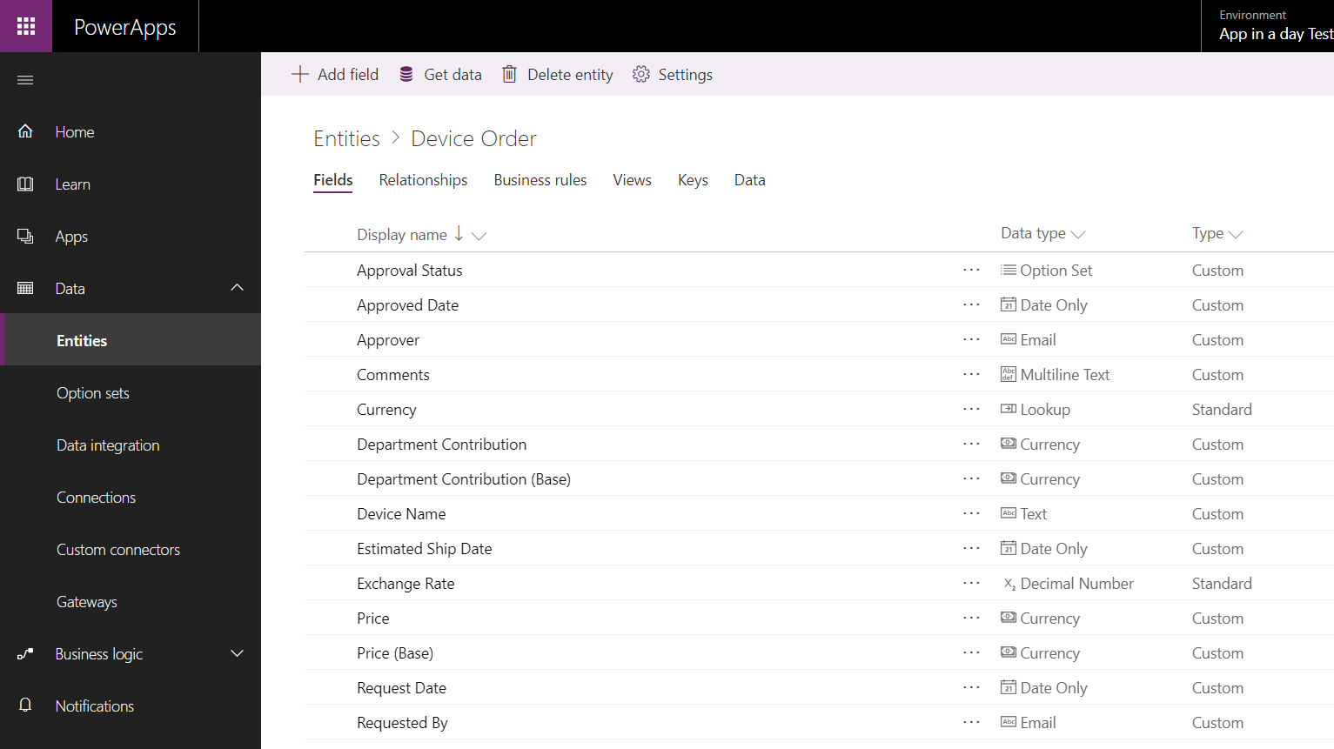
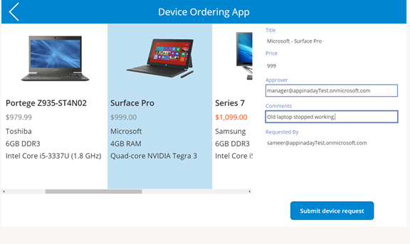
Module 2: Learning objectives
Canvas App
Dataverse
Model- driven
App
Power Automate
Provision a database, if you haven’t already done this
Work with entities
Get familiar with standard tables
Create a custom tables
Customize table columns and choices
Create calculated fields
Work with canvas app
Use the canvas app form control to save data
Use the Office 365 connector to get user’s manager info
Configure canvas app settings
Save and share a canvas app
Run a canvas app on a mobile device

Slide 8
Hands-on-lab 3
Module 3: Power Apps Model-driven App

Slide 9
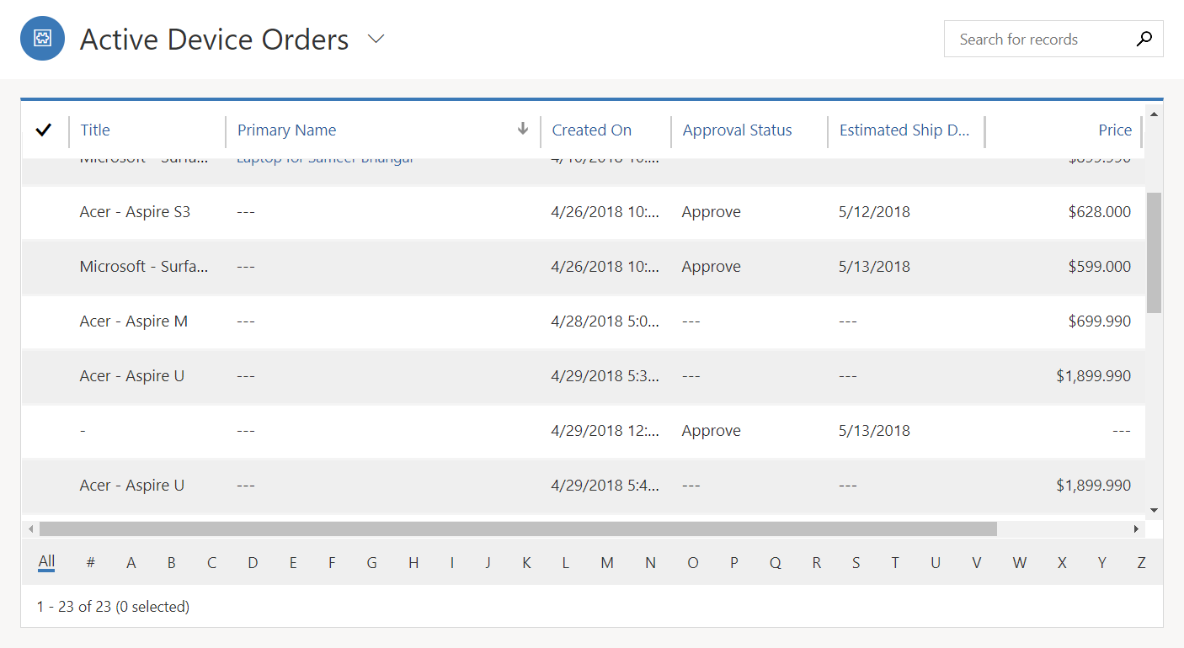
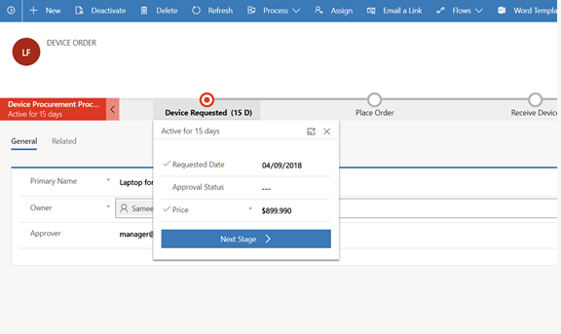
Module 3: Learning objectives
Canvas App
Dataverse
Model- driven
App
Power Automate
Create a standalone Model-driven app
Customize forms for the Model-driven app
Create a Business Process Flow

Slide 10
Hands-on-lab 4
Module 4: Power Automate

Slide 11
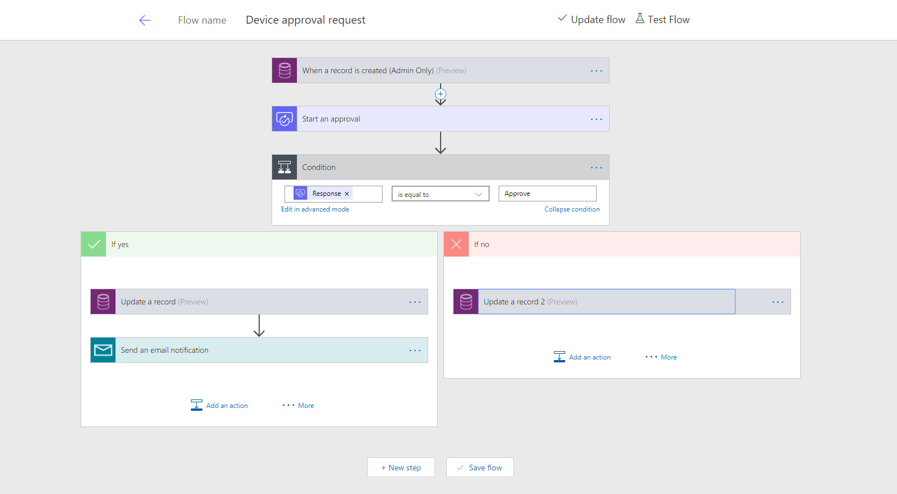
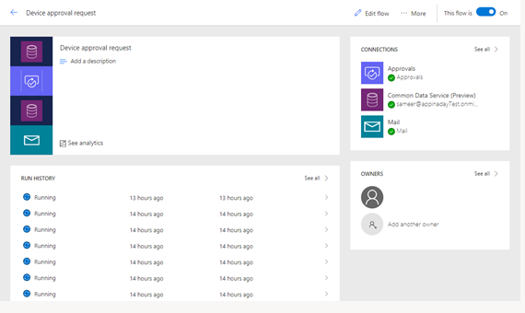
Module 4: Learning objectives
Canvas App
Dataverse
Model- driven
App
Power Automate
Trigger a flow when a new record is created
Send an approval request
Conditional branching based on the approval response
Send email notifications
Update the record with the approval status and the approver’s comments
Use the approval center on web and mobile
Check the status of flow runs

Slide 12
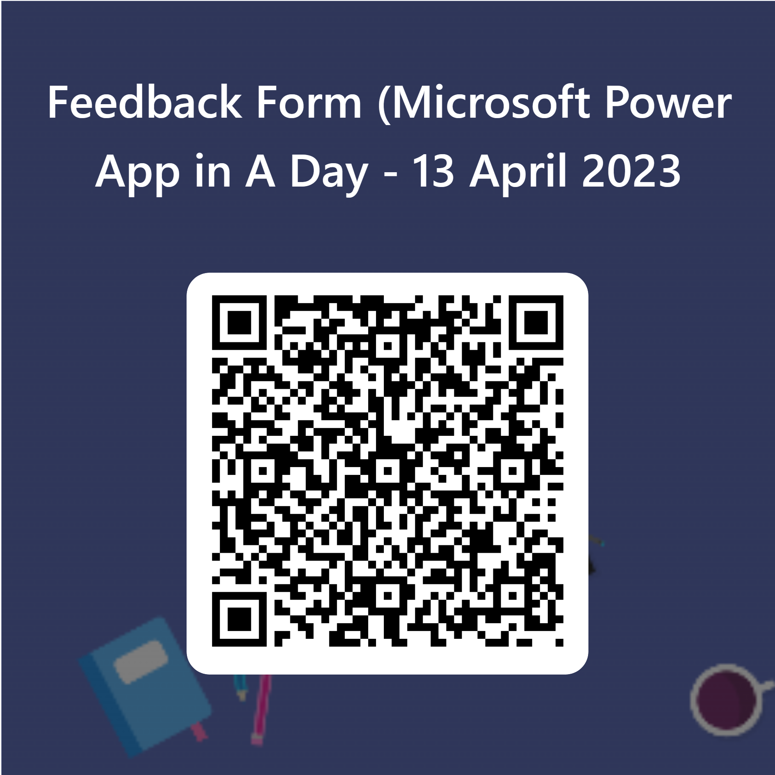

Feedback Form
https://forms.office.com/r/kFx6HF1ry9
Notes:
https://forms.office.com/r/pvw9TuagbL

Slide 13
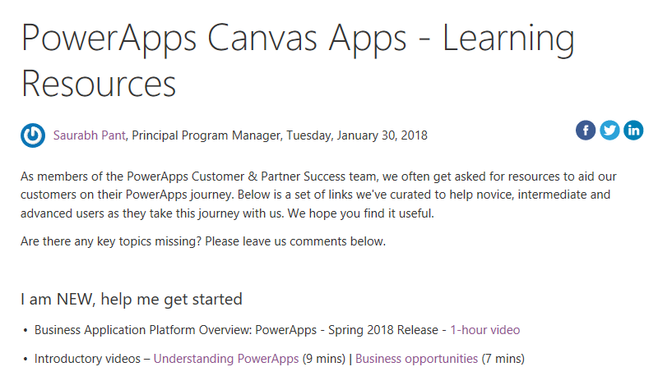
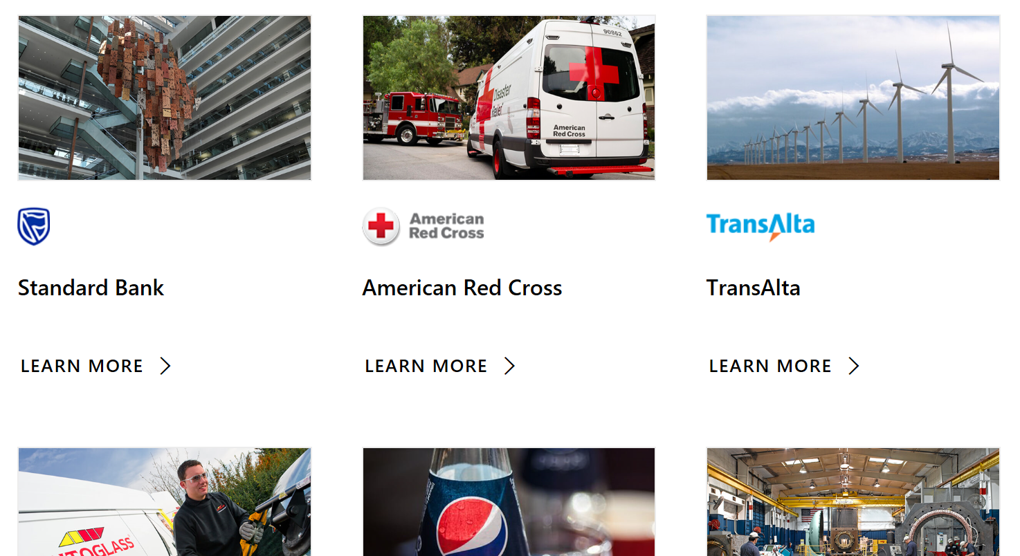
Learning resources and Customer stories
Learning resources
http://aka.ms/powerapps-resources
http://aka.ms/flow-resources
Customer stories
http://aka.ms/PowerAppsStories
http://aka.ms/GJPepsiVideo
http://aka.ms/ArrivaVideo
http://aka.ms/HeathrowVideo

Slide 14
Closing Slide

